Slide 1

CSE2PM09A / AID2PM07A
Design and Analysis of Algorithm
Department of Computer Science and Engineering

Slide 2
Unit 1: Analysis of Algorithm
Efficiency: Analysis framework, asymptotic notations – big O, theta and omega.
Analysis of Non-recursive and recursive algorithms: Solving Recurrence Equations using Masters theorem and Substitution method.
Searching: Search Techniques-Sequential Search/Linear Search, Binary Search.

Slide 3
Why Study this Course?
Donald E. Knuth stated “Computer Science is the study of algorithms”
  Cornerstone of computer science. Programs will not exist without algorithms.
Algorithms are needed (most of which are novel) to solve the many problems listed here
  Computational Primitives –CG –Geometric Algorithms
  Communication Network –Shortest path Algorithms
  Genome Structure in Bioinformatics –Dynamic Programming
  Search engines –Page Rank Algorithm by Google
  Challenging (i.e. Good for brain !!!)
Real Blend of Creativity and Precision
Very interesting if you can concentrate on this course
Notes:
But let me begin by justifying this course's existence. And giving you some reasons why you should be highly motivated to learn about algorithms.

Slide 4
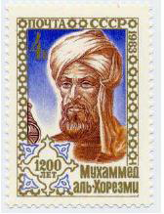
Algorithm: A brief History
The word algorithm comes from the name of Persian author, Abu Ja’far Mohammed ibn Musa al Khowarizmi (c. 825 A.D.), who wrote a textbook on mathematics.
The book was translated into Latin in the 12th century under the title Algoritmi de numero Indorum. This title means "Algoritmi on the numbers of the Indians", where "Algoritmi" was the translator's Latinization of Al-Khwarizmi's name.
Many centuries later, decimal system was adopted in Europe, and the procedures in Al Khwarizmi’s book were named after him as “Algorithms”.
Notes:
algorism

Slide 5
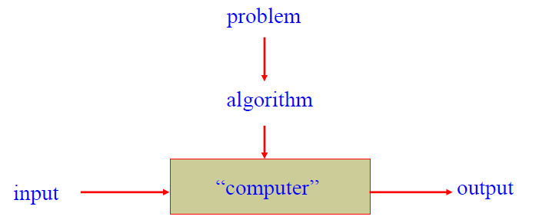
What is an Algorithm?
An algorithm is a sequence of unambiguous instructions for solving a computational problem i.e., for obtaining a required output for any legitimate input in a finite amount of time.
It is any well defined computational procedure that takes some value or set of values as input and produces some value, or set of values as output

Slide 6
Algorithm & its Properties
More precisely, An algorithm is a finite set of instructions that accomplishes a particular task.
Algorithm must satisfy the following properties:
Input
  Valid inputs must be clearly specified.
Output
  can be proved to produce the correct output given a valid input.
Finiteness
  terminates after a finite number of steps
Definiteness
  Each instruction must be clear and unambiguously specified
Effectiveness
  Every instruction must be sufficiently simple and basic.

Slide 7
Examples of Algorithms – Computing the Greatest Common Divisor of Two Integers
Problem: Find gcd (m,n), the greatest common divisor of two nonnegative, not both zero integers m and n
//First try –School level algorithm:
Step1: factorize m.( m ← m1*m2*m3…)
Step2: factorize n. (n ← n1*n2*…)
Step 3: Identify common factors , multiply and return.

Slide 8
Pseudocode of Euclid’s Algorithm
Algorithm : Euclid (m, n)
//Computes gcd(m, n) by Euclid’s algorithm
//Input: Two non negative, not-both-zero integers m and n
//Output: Greatest common divisor of m and n gcd(m, n) = gcd(n, m mod n)
While (m does not divide n) do
  r ← n mod m
  n ← m
    m ← r
return m
Questions:
Finiteness: how do we know that Euclid’s algorithm actually comes to a stop?
Definiteness: non-ambiguity
Effectiveness: effectively computable.
Which algorithm is faster, the Euclid’s or previous one?

Slide 9
Example of Euclid’s Algorithm
Simple Algorithm
m = 36, n = 48
m = 2 * 2 * 3 * 3
n = 2 * 2 * 2 * 2 * 3
Common factors
2, 2, 3
GCD = 12
9 divisions
Euclid Algorithm
36 divides 48
r = 48 mod 36
n = 36
m = 12
Return 12
2 divisions
Another example:
  m = 434 and n = 966

Slide 10
Fundamentals of Algorithmic Problem Solving
Understanding the problem
  Asking questions, do a few examples by hand, think about special cases, etc.
Deciding on
  Exact vs. approximate problem solving
Appropriate data structure
Design an algorithm
Proving correctness
Analyzing an algorithm
  Time efficiency : how fast the algorithm runs
  Space efficiency: how much extra memory the algorithm needs.
Coding an algorithm

Slide 11
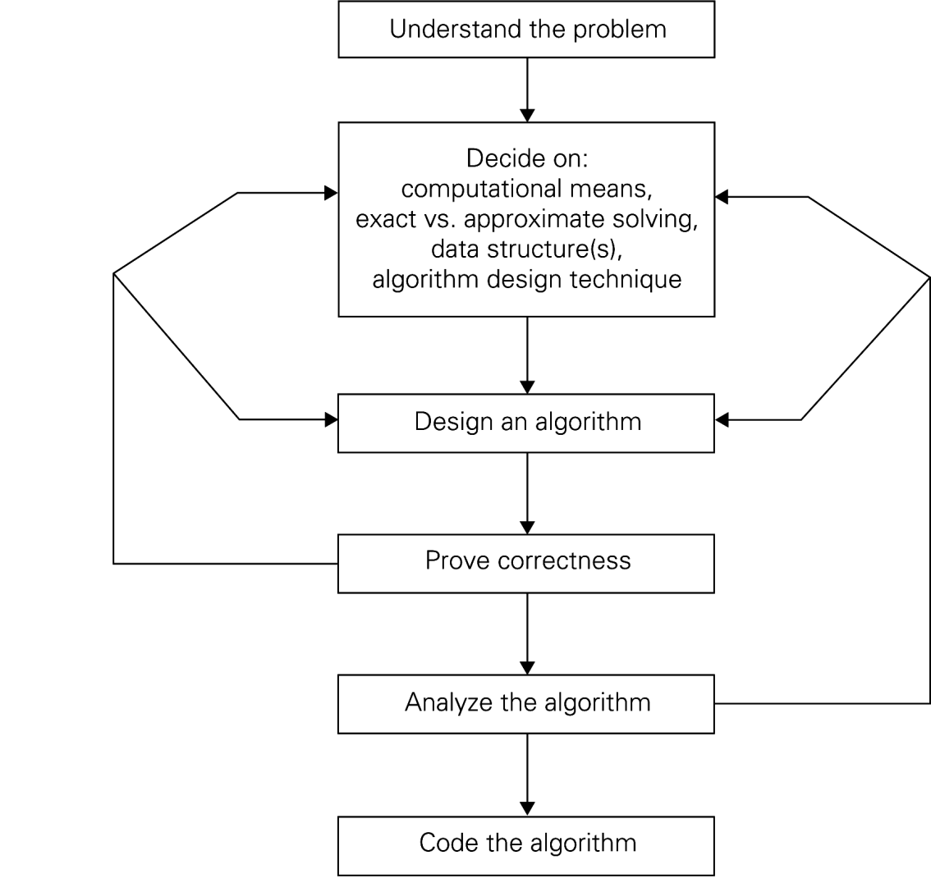
Algorithm Design and Analysis Process

Slide 12
Algorithms as a Technology
Even if computers were infinitely fast and memory was plentiful and free
  Study of algorithms still important – still need to establish algorithm correctness
  Since time and space resources are infinitely fast, any correct algorithm for solving a problem would do.
Real-world computers may be fast but not infinitely fast.
Memory is cheap but not free
Hence Computing time is bounded resource and so need space in memory.
We should use resources wisely by efficient algorithm in terms of space and time

Slide 13
Algorithm Efficiency
Time and space efficiency are the goal
Algorithms often differ dramatically in their efficiency
  Example: Two sorting algorithms
    INSERTION-SORT – time efficiency is c₁n²
    MERGE-SORT – time efficiency is c₁nlogn
  For which problem instances would one algorithm be preferable to the other?
  For example,
  A faster computer ‘A’ (10¹⁰ instructions/sec) running insertion sort against a slower computer ‘B’ (10⁷instructions/sec) running merge sort. Suppose that c1=2，c2=50 and n= 10⁷.
Notes:
C1 and c2 not depend on input size n

Slide 14
Efficiency
Machine A
Insertion- Sort
Machine B
Merge- Sort
Problem Size
n | 2n²/10⁹ | 50nlogn/10⁷
10,000 | 0.20 | 0.66
50,000 | 5.00 | 3.90
100,000 | 20.00 | 8.30
500,000 | 500.00 | 47.33
1,000,000 | 2,000.00 | 99.66
5,000,000 | 50,000.00 | 556.34
10,000,000 | 200,000.00 | 1,162.67
50,000,000 | 5,000,000.00 | 6,393.86

Slide 15
Methods of Specifying an Algorithm
Natural language
  Ambiguous
  Example : “Mike ate the sandwich on a bed.”
Flowchart
  Graphic representations called flowcharts , only if the algorithm is small and simple.
Pseudocode
  A mixture of a natural language and programming language-like structures
  Precise and concise.
Pseudocode in this course
  omits declarations of variables
  use indentation to show the scope of such statements as for, if, and while.
  use ← for assignment

Slide 16
Pseudocode Conventions
Comments begin with // and continue until the end of line.
Blocks are indicated with matching braces :{ and }. A compound statement (i.e., a collection of simple statements) can be represented as as a block. The body of a procedure also forms a block. Statements are delimited by;
Assignment of values to variables is done using the assignment statement
〈variable〉≔〈expression〉;
There are two Boolean values true and false. In order to produce these values,
  Logical operators : and, or, and not
  Relational operators<, ≤, =, ≠, ≥, and >
Elements of multidimensional arrays are accessed using [ and ]. Ex A[i,j]

Slide 17
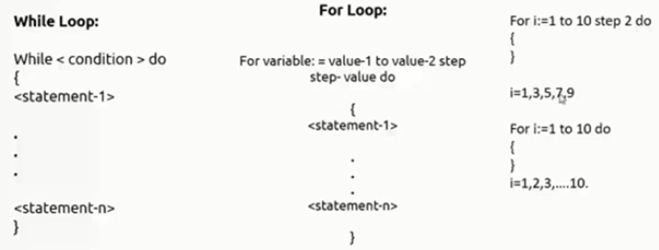
Pseudocode Conventions
Looping statement can be employed as follows :
( while, for , repeat-until )
A conditional statement has the following forms:
    If 〈condition〉 then 〈statement〉
    If 〈condition〉 then 〈statement 1〉 else 〈statement 2〉
We also employ the following case statement:
case
{
: 〈condition 1〉: 〈statement 1〉
.
: 〈condition n〉: 〈statement n〉
: else: 〈statement n + 1〉
}

Slide 18
Pseudocode Conventions
Ref Book Sahni
Input and output are done using the instructions read and write. No format is used to specify the size of input or output quantities.
An algorithm consists of a heading and a body. The heading takes the form
Algorithm Name (〈parameter list〉)
{
// body
}
Example : Algorithm to find and return the maximum of n given numbers:
Algorithm Max (A, n)
// A is an array of size n.
{
Result ≔A[1];
For i ≔2 to n do
If A[i] > Result then Result ≔A[i];
Return Result;
}

Slide 19
Analysis of Algorithms
Two main issues related to algorithms
How to design algorithms
How to analyze algorithm efficiency
Analysis of Algorithms
How good is the algorithm?
  time efficiency
  space efficiency
Does there exist a better algorithm?
  lower bounds
  optimality

Slide 20
Common Rates of Growth
Let n be the size of input to an algorithm, and k some constant. The following are common rates of growth.
Constant: Θ(k), for example Θ(1)
Linear: Θ(n)
Logarithmic: Θ(log_{k} n)
Linear : n Θ(n) or n log n: Θ(n log_{k} n)
Quadratic: Θ(n² )
Polynomial: Θ(n^{k} )
Exponential: Θ(k^{n})

Slide 21
Why Analyse?
Practical reasons:
  Resources are scarce
  Greed to do more with less
  Avoid performance bugs
Core Issues:
Predict performance
  How much time does binary search take?
Compare algorithms
  How quick is Quicksort?
Provide guarantees
  Size not with standing, Red-Black tree inserts in O(log n)
Understand theoretical basis
  Sorting by comparison cannot do better than (n log n)

Slide 22
What to analyse?
Ref Book: NPTEL
Ref Book: NPTEL
Core Issue: Cannot control what we cannot measure
Time
  The time complexity, T(n), taken by a program P is the sum of the running times for each statement executed
  Space
  The space complexity of a program is the amount of memory that it needs to run to completion
Examples : Sum of Natural Numbers
    // Sum of Natural Numbers
    Algorithm sum (a, n)
    {
    s := 0 ;
    For i := 1 to n do
    s := s + a[i];
    return s;
    }
Time T(n) = n (additions)
Space S(n) = 2 (n, s)
Notes:
Whatever can be measured that we want to analyze

Slide 23
Tabular Method
Ref Book Sahni
Iterative function to sum a list of numbers (steps/execution )
Machine Model: Random Access Machine (RAM) Computing Model
  Input data & size
  Operations
  Intermediate Stages
  Output data & size

Slide 24
Asymptotic Analysis
Core Idea: Cannot compare actual times; hence compare Growth or how time increases with input
O notation (“Big Oh”)
Ω notation (Omega)
Θ notation (Theta)
o notation (Little oh)
ω notation (Little omega)

Slide 25
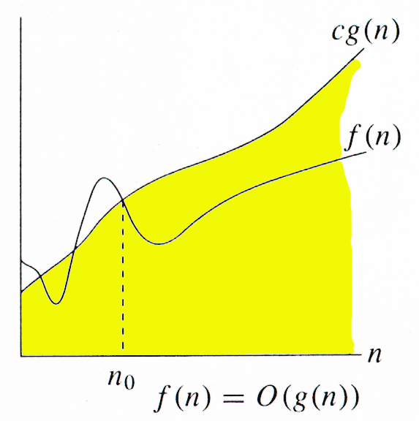
ASYMPTOTICS NOTATIONS
O-notation (Big Oh)
Asymptotic Upper Bound
For a given function g(n), we denote O(g(n)) as the set of
functions:
O(g(n)) = { f(n)| there exists positive constants c and n0
such that 0 ≤ f(n) ≤ c g(n) for all n ≥ n0 }
It is used to represent the worst case growth of an algorithm
in time or a data structure in space when they are
dependent on n, where n is big enough
Example :

Slide 26
Big Oh - Example
f(n) = n²+ 5n = O(n2)
g(n) = n² ……… c = 2
  n n²+ 5n 2n²
1 5 2
2 14 8
5 50 50
f(n) <= c g(n) for all n> = n₀ where c=2 & n₀ =5

Slide 27
Big Oh - Example
Let f(N) = 2N². Then
  f(N) = O(N⁴) (loose bound)
  f(N) = O(N³) (loose bound)
  f(N) = O(N²) (It is the best answer and the bound is asymptotically tight.)
O(N²): reads “order N-squared” or “Big-Oh N-squared”.

Slide 28
Big Oh - Example
Prove that if T(n) = 15n³ + n² + 4, T(n) = O(n³).
Proof.
Let c = 20 and n₀ = 1.
Must show that 0 ≤ f (n) and f (n) ≤ cg(n).
0≤15n³ + n² + 4 for all n ≥ n₀ = 1.
f (n) = 15n³ + n² + 4 ≤ 20n³ (20g(n) = cg(n))
As per defination of Big O, hence T(n) = O(n³)

Slide 29
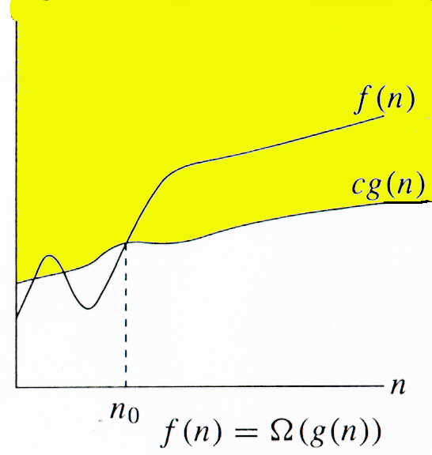
ASYMPTOTICS NOTATIONS
Ω-notation
Asymptotic lower bound
Ω (g(n)) represents a set of functions such that:
Ω(g(n)) = {f(n): there exist positive
    constants c and n0 such that
    0 ≤ c g(n) ≤ f(n) for all n≥ n0}

Slide 30
Big Omega - Example
Example 1 :
f(n) = n²+ 5n
g(n) = n² ……… c = 1
  n n²+ 5n c*n²
¹ ⁵ ¹
2 14 4
5 50 25
f(n) >= c g(n) for all n> = n₀ where c=1 & n₀ =1
Example 1 :
Prove that if T(n) = 15n³ + n² + 4, T(n) = Ω (n³).
Proof.
Let c = 15 and n₀ = 1.
Must show that 0 ≤ cg(n) and cg(n) ≤ f (n).
0 ≤ 15n³ for all n ≥ n₀ = 1.
cg(n) = 15n³ ≤ 15n³ + n² + 4 = f (n)

Slide 31
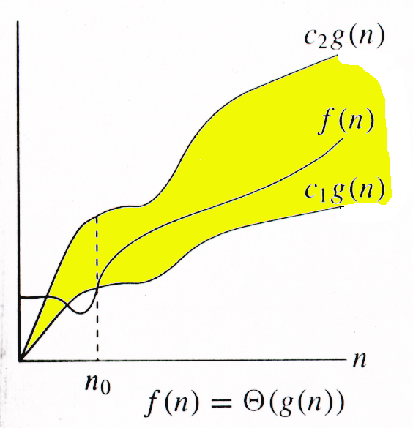
ASYMPTOTICS NOTATIONS
Θ-notation
Asymptotic tight bound
Θ (g(n)) represents a set of functions such that:
Θ (g(n)) = {f(n): there exist positive
    constants c1, c2, and n0such
    that 0 ≤ c1g(n) ≤ f(n) ≤ c2g(n)
    for all n≥ n0 }

Slide 32
Theta Example
f(N) = Θ(g(N)) iff f(N) = O(g(N)) and f(N) = Ω(g(N))
It can be read as “f(N) has order exactly g(N)”.
The growth rate of f(N) equals the growth rate of g(N). The
growth rate of f(N) is the same as the growth rate of g(N)
for large N.
Theta means the bound is the tightest possible.
If T(N) is a polynomial of degree k, T(N) = Θ(N^{k}).
For logarithmic functions, T(log_{m} N) = Θ(log N).

Slide 33
o notation (Little oh)
The function f(n) = o(g(n)) iff
o(g(n)) = {f(n): ∀ c > 0, ∃ n₀ > 0 such that
∀ n ≥ n₀, we have 0 ≤ f(n) < cg(n)}.
Example: The function 3n + 2 = o(n²) as

Slide 34
ω notation (Little omega)
The function f(n) = ω(g(n)) iff
ω(g(n)) = {f(n): ∀ c > 0, ∃ n₀ > 0 such that
∀ n ≥ n₀, we have 0 ≤ cg(n) < f(n)}.

Slide 35
Asymptotic Notations
It is a way to compare “sizes” of functions
O-notation ------------------Less than equal to (“≤”)
Θ-notation ------------------Equal to (“=“)
Ω-notation ------------------Greater than equal to (“≥”)
O ≈ ≤
Ω ≈ ≥
Θ ≈ =
o ≈ <
ω ≈ >

Slide 36
Examples On Asymptotic Notations
Explain How is f(x) = 4n^2 – 5n + 3 is O(n^2)
Show that
30n+8 is O(n)
100n + 5 ≠ Ω(n²)
5n² = Ω(n)
100n + 5 = O(n²)
n²/2 –n/2 = Θ(n²)

Slide 37
Algorithm Design Techniques/Strategies
Brute force
Divide and conquer
Space and time tradeoffs
Greedy approach
Dynamic programming
Backtracking
Branch and bound

Slide 38
Methods for Solving recurrences
Substitution Method
  We guess a bound and then use mathematical induction to prove our guess correct.
Recursion Tree
  Convert recurrence into tree
Master Method

Slide 39
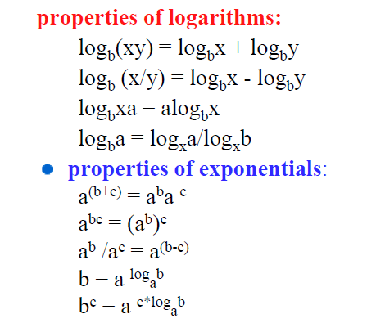
Math You need to Review

Slide 40
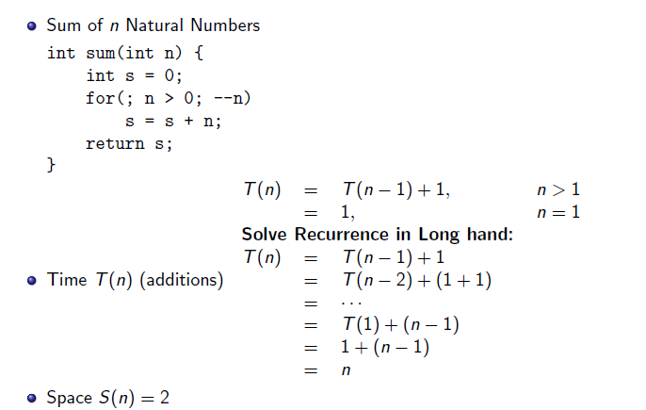
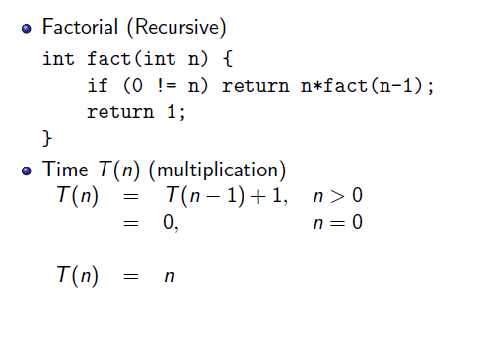
Substitution Method

Slide 41
Quick Sort

Slide 42
Binary Search

Slide 43
Master Theorem
Master method provides a “cookbook” method for solving recurrences of the following form
T(n) = a T(n/b) + f(n)
where a ≥ 1, b > 1. If f(n) is asymptotically positive function. T(n) has following asymptotic bounds:
There are 3 cases:

Slide 44
Master Method (Simplified)
Let T(n) be a monotonically increasing function that satisfies
T(n) = a T(n/b) + f(n)
T(1) = c
where a ≥ 1, b ≥ 2, c>0. If f(n) is Θ(n^{d}) where d ≥ 0 then solution to recurrence relation is given as
Case 1: T(n) ϵ -------- if a < b^{d}
Case 2: T(n) ϵ -------- if a = b^{d}
Case 3: T(n) ϵ -------- if a > b^{d}

Slide 45
Example of Master Method
To use the master theorem, we simply plug the numbers into the formula

Slide 46

References
Thomas H Cormen and Charles E.L Leiserson, "Introduction to Algorithm" PHI Third Edition
Horowitz and Sahani, "Fundamentals of Computer Algorithms", 2ND Edition. University Press, ISBN: 978 81 7371 6126, 81 7371 61262.

Slide 47
Searching
Searching is the process of determining whether or not a given value exists in a data structure or a storage media.
Two searching methods are: linear search and binary search.
The linear (or sequential) search algorithm on an array is:
  1. Sequentially scan the array, comparing each array item with the searched value.
  2. If a match is found; return the index of the matched element; otherwise return –1.

Slide 48
Searching
When we maintain a collection of data, one of the operations we need is a search routine to locate desired data quickly.
Here’s the problem statement:
Given a value X, return the index of X in the array, if such X exists. Otherwise, return NOT_FOUND (-1). We assume there are no duplicate entries in the array.
We will count the number of comparisons in the algorithms
- The ideal searching algorithm will make the least possible number of comparisons to locate the desired data.
– Two separate performance analyses are normally done, one for
successful search and another for unsuccessful search.

Slide 49
Linear Search Algorithm
Algorithm Search(array,target,size)
{
for i=1 to size do
{
if(array[i] = target)
{
print(“Target data found”)
break;
}
}
if(i >=size)
print(“Target not found”)
}
Scan the array

Slide 50
Algorithm Search(array,target,size)
{
for i=1 to size do
{
if(array[i] = target)
{
print(“Target data found”)
break;
}
}
if(i>size)
print(“Target not found”)
}
array
7
12
5
22
13
32
target = 13
1
2
3
4
5
6

Slide 51
Algorithm Search(array,target,size)
{
for i=1 to size do
{
if(array[i] = target)
{
print(“Target data found”)
break;
}
}
if(i>=size)
print(“Target not found”)
}
array
7
12
5
22
13
32
target = 13
1
2
3
4
5
6

Slide 52
Algorithm Search(array,target)
{
for i=1 to size do
{
if(array[i] = target)
{
print(“Target data found”)
break;
}
}
if(i>=size)
print(“Target not found”)
}
array
7
12
5
22
13
32
target = 13
1
2
3
4
5
6

Slide 53
Algorithm Search(array,target,size)
{
for i=1 to size do
{
if(array[i] = target)
{
print(“Target data found”)
break;
}
}
if(i>=size)
print(“Target not found”)
}
array
7
12
5
22
13
32
target = 13
1
2
3
4
5
6

Slide 54
Algorithm Search(array,target,size)
{
for i=1 to size do
{
if(array[i] = target)
{
print(“Target data found”)
break;
}
}
if(i>=size)
print(“Target not found”)
}
array
7
12
5
22
13
32
target = 13
1
2
3
4
5
6

Slide 55
Algorithm Search(array,target,size)
{
for i=1 to size do
{
if(array[i] = target)
{
print(“Target data found”)
break;
}
}
if(i>=size)
print(“Target not found”)
}
array
7
12
5
22
13
32
target = 13
1
2
3
4
5
6

Slide 56
Algorithm Search(array,target,size)
{
for i=1 to size do
{
if(array[i] = target)
{
print(“Target data found”)
break;
}
}
if(i>=size)
print(“Target not found”)
}
array
7
12
5
22
13
32
target = 13
1
2
3
4
5
6

Slide 57
Algorithm Search(array,target,size)
{
for i=1 to size do
{
if(array[i] = target)
{
print(“Target data found”)
break;
}
}
if(i>=size)
print(“Target not found”)
}
Target data found
array
7
12
5
22
13
32
target = 13
1
2
3
4
5
6

Slide 58
Algorithm Search(array,target,size)
{
for i=1 to size do
{
if(array[i] = target)
{
print(“Target data found”)
break
}
}
if(i>=size)
print(“Target not found”)
}
array
7
12
5
22
13
32
target = 13
1
2
3
4
5
6

Slide 59
Linear Search Analysis: Best Case
Algorithm Search(array,target,size)
{
for i=1 to size do
{
if(array[i] = target)
{
print(“Target data found”)
break;
}
}
if(i>=size)
print(“Target not found”)
}
Best Case:
1 comparison
Best Case: match with the first item
7
12
5
22
13
32
target = 7

Slide 60
Linear Search Analysis: Worst Case
Algorithm Search(array,target,size)
{
for i=1 to size do
{
if(array[i] = target)
{
print(“Target data found”)
break;
}
}
if(i>=size)
print(“Target not found”)
}
Worst Case:
N comparisons
Worst Case: match with the last item (or no match)
7
12
5
22
13
32
target = 32

Slide 61
Linear Search Animation
Linear Search Animation :
https://yongdanielliang.github.io/animation/web/LinearSearchNew.html

Slide 62
Sequential search
int seqsearch(int key)
{
for i= 0 to n
{
if(key==a[i])
{
pos=i;
flag=1;
break;
}
}
if(flag==1)
return pos;
else
return -1;
}
class search
{
int a[20],n;
public:
int seqsearch(int);
void accept();
void display();
};

Slide 63
Linear Search Performance
We analyze the successful and unsuccessful searches separately.
We count how many times the search value is compared against the array elements.
Successful Search
– Best Case – 1 comparison
– Worst Case – N comparisons (N – array size)
Unsuccessful Search
– Best Case = Worst Case – N comparisons

Slide 64
Sentinel search
The algorithm ends either when the target is found or when the last element is compared
The algorithm can be modified to eliminate the end of list test by placing the target at the end of list as just one additional entry
This additional entry at the end of the list is called as sentinel

Slide 65
Sentinel search
int seqsearch_sentinel(int key)
{
last=a[n-1];
a[n-1]=key; //place target at the end of the list
i=0;
while (key!=a[i])
{
i++;
}
arr[n-1]=last;
if((i<n-1) || (a[n-1]==key))
return i;
else
return -1; //not found
}

Slide 66
Binary Search
If the array is sorted, then we can apply the binary search technique.
The basic idea is straightforward. First search the value in the middle position.
If X is less than this value, then search the middle of the left half next.
If X is greater than this value, then search the middle of the right half next.

Slide 67
Binary Search
Binary search. Given value and sorted array a[], find index i
such that a[i] = value, or report that no such index exists.
Invariant. Algorithm maintains a[lo] ≤ value ≤ a[hi].
Ex. Binary search for 33.
6
13
14
25
33
43
51
53
64
72
84
93
95
96
97
0
1
2
3
4
5
6
7
8
9
10
11
12
13
14
lo
hi

Slide 68
Binary Search
Binary search. Given value and sorted array a[], find index i
such that a[i] = value, or report that no such index exists.
Invariant. Algorithm maintains a[lo] ≤ value ≤ a[hi].
Ex. Binary search for 33.
6
13
14
25
33
43
51
53
64
72
84
93
95
96
97
0
1
2
3
4
5
6
7
8
9
10
11
12
13
14
lo
mid
hi

Slide 69
Binary Search
Binary search. Given value and sorted array a[], find index i
such that a[i] = value, or report that no such index exists.
Invariant. Algorithm maintains a[lo] ≤ value ≤ a[hi].
Ex. Binary search for 33.
6
13
14
25
33
43
51
53
64
72
84
93
95
96
97
0
1
2
3
4
5
6
7
8
9
10
11
12
13
14
lo
hi

Slide 70
Binary Search
Binary search. Given value and sorted array a[], find index i
such that a[i] = value, or report that no such index exists.
Invariant. Algorithm maintains a[lo] ≤ value ≤ a[hi].
Ex. Binary search for 33.
6
13
14
25
33
43
51
53
64
72
84
93
95
96
97
0
1
2
3
4
5
6
7
8
9
10
11
12
13
14
lo
mid
hi

Slide 71
Binary Search
Binary search. Given value and sorted array a[], find index i
such that a[i] = value, or report that no such index exists.
Invariant. Algorithm maintains a[lo] ≤ value ≤ a[hi].
Ex. Binary search for 33.
6
13
14
25
33
43
51
53
64
72
84
93
95
96
97
0
1
2
3
4
5
6
7
8
9
10
11
12
13
14
lo
hi

Slide 72
Binary Search
Binary search. Given value and sorted array a[], find index i
such that a[i] = value, or report that no such index exists.
Invariant. Algorithm maintains a[lo] ≤ value ≤ a[hi].
Ex. Binary search for 33.
6
13
14
25
33
43
51
53
64
72
84
93
95
96
97
0
1
2
3
4
5
6
7
8
9
10
11
12
13
14
lo
mid
hi

Slide 73
Binary Search
Binary search. Given value and sorted array a[], find index i
such that a[i] = value, or report that no such index exists.
Invariant. Algorithm maintains a[lo] ≤ value ≤ a[hi].
Ex. Binary search for 33.
6
13
14
25
33
43
51
53
64
72
84
93
95
96
97
0
1
2
3
4
5
6
7
8
9
10
11
12
13
14
lo
hi

Slide 74
Binary Search
Binary search. Given value and sorted array a[], find index i
such that a[i] = value, or report that no such index exists.
Invariant. Algorithm maintains a[lo] ≤ value ≤ a[hi].
Ex. Binary search for 33.
6
13
14
25
33
43
51
53
64
72
84
93
95
96
97
0
1
2
3
4
5
6
7
8
9
10
11
12
13
14
lo
hi
mid

Slide 75
Binary Search
Binary search. Given value and sorted array a[], find index i
such that a[i] = value, or report that no such index exists.
Invariant. Algorithm maintains a[lo] ≤ value ≤ a[hi].
Ex. Binary search for 33.
6
13
14
25
33
43
51
53
64
72
84
93
95
96
97
0
1
2
3
4
5
6
7
8
9
10
11
12
13
14
lo
hi
mid

Slide 76
Example: Binary Search
Searching for an element k in a sorted array A with n elements
Idea:
  Choose the middle element A[n/2]
  If k == A[n/2], we are done
  If k < A[n/2], search for k between A[0] and A[n/2 -1]
  If k > A[n/2], search for k between A[n/2 + 1] and A[n-1]
  Repeat until either k is found, or no more elements to search
Requires less number of comparisons than linear search in the worst case (log₂n instead of n)

Slide 77
Linear Search and Binary search Animation
Linear Search Animation :
https://www.cs.usfca.edu/~galles/visualization/Search.html

Slide 78
Time Complexity of Binary Search
The maximum no of elements after 1 comparison =n/2
The maximum number of elements after 2 comparisons =n/2²
The maximum number of elements after h comparisons =n/2^{h}
^{For} the lowest value of h elements 1 left
n/2^{h=1 or} 2^{h=n h=log}₂^{(n)=O(log}₂ ^{n)}

Slide 79
Binary Search Algorithm
Algorithm binary_search(a[], low, high, key) {
while(low<=high) {
mid=(low+high)/2;
if(a[mid]==key) {
flag=1;
return flag; } //end if
else if (key<a[mid])
high=mid-1;
else
low=mid+1;
} //end while
If (flag==0)
{ return flag;}
}//end binary_search
Look for 42
1 7 9 12 33 42 59 76 81 84 91 92 93 99
0 | 1 | 2 | 3 | 4 | 5 | 6 | 7 | 8 | 9 | 10 | 11 | 12 | 13

Slide 80
Binary search(recursive)
Algorithm binary_search(a[], low, high, key)
{
if(low<=high) {
mid=(low+high)/2;
if(a[mid]==key)
return mid;
else if (key<a[mid])
return binary_search(a,low,mid-1,key);
else
return binary_search(a,mid+1,high,key);}
return -1;
}

